Slide 1
IEP Team
Notes:
I am like Lady Godiva at the end of the street. I am nearing my clothes (close).

Slide 2
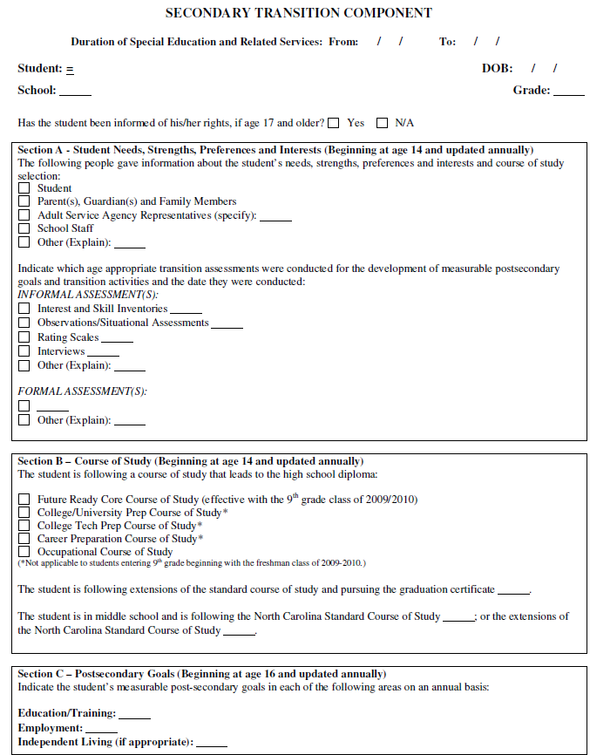
IEP Team
Develops the IEP including the transition component for a single student

Slide 3
Indicator 13
Percent of youth with IEPs aged 16 and above with an IEP that includes appropriate measurable postsecondary goals that are annually updated and based upon an age appropriate transition assessment, transition services, including courses of study, that will reasonably enable the student to meet those postsecondary goals, and annual IEP goals related to the student’s transition services needs. There also must be evidence that the student was invited to the IEP Team meeting where transition services are to be discussed and evidence that, if appropriate, a representative of any participating agency was invited to the IEP Team meeting with the prior consent of the parent or student who has reached the age of majority. [20 U.S.C. 1416(a)(3)(B)]

Slide 4
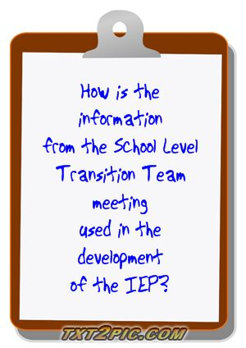

Slide 5
Is there an appropriate measurable postsecondary goal or goals that covers education or training, employment, and, as needed, independent living?
Is (are) the postsecondary goal(s) updated annually?
Use information from student regarding future desires for employment,
education and independent living
Use input from team members that helped focus the student’s stated desires for employment, education and independent living
Consider if additional assessment or information is needed to focus or determine goals in one or more domains.
Consider if the goals will need to be updated more than once during the upcoming year
Notes:
Use information student provided regarding future desires for employment, education and independent living (EXAMPLE – Where all major domains addressed?
Use input from team members that may have helped focus the student’s stated desires for employment, education and independent living (EXAMPLE -
Consider if additional assessment or information is neededto focus goals (EXAMPLE -
Consider if the goals will need to be updated more than once during the upcoming year (EXAMPLE -

Slide 6
Is there evidence that the measurable postsecondary goal(s) were based on age-appropriate transition assessment?
School administered assessment information | Agency administered assessment information | Work-based assessment information
What assessment information has been or can be gathered through the school? | What assessment information has been or can be gathered from outside agencies? | What assessment information from vocational experiences has been or can be gathered?

Slide 7
Are there transition services in the IEP that will reasonably enable the student to meet his or her postsecondary goal(s)?
Collaborative Activities
Transition Assessment
Job Skill Training
Obtaining funding for post-secondary goals
Job Development
Agency Linkages

Slide 8
Do the transition services include courses of study that will reasonably enable the student to meet his or her postsecondary goal(s)?
Is (are) there annual IEP goal(s) related to the student’s transition services needs?
What does the student need to learn to achieve his/her goals?
Where can the student obtain these skills?
What agencies have resources to assist with skill attainment?
Notes:
What does the student need to learn to accomplish his/her goals?
Where can the student obtain these skills?
What agencies have resources to assist with skill attainment?

Slide 9
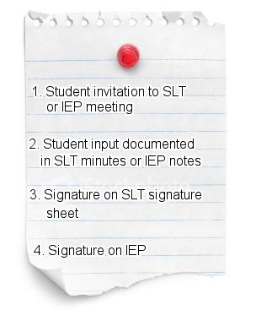
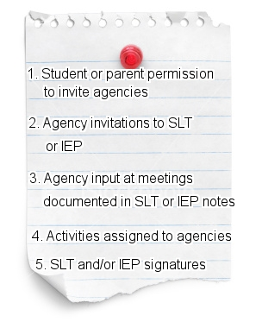
Is there evidence that the student was invited to the IEP Team meeting where transition services were discussed?
If appropriate, is there evidence that a representative of any participating agency was invited to the IEP Team meeting with the prior consent of the parent or student who has reached the age of majority?

Slide 10
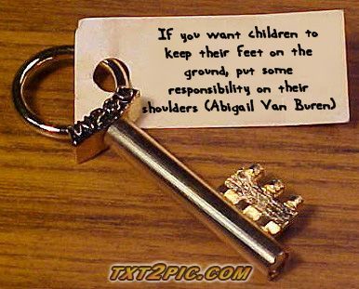

Slide 11
WHY?
IDEA Mandate
Research proven benefits
High drop-out rates
Low graduation rates
Student belief that curriculum is not relevant
Low student motivation
Need to understand student needs
Notes:
Research proven benefits to students
Learn more about their disability – how to talk about it and explain it to others
Learn more about accommodations and modifications needed for success
Become more involved in their education
Learn advocacy skills (self-determination – problem solving – self evaluation – choice making – decision making)
Learn compromise
See how people work together
Develop leadership skills

Slide 12
Notes:
Preschool through 22
Any disability
Any instructional setting
Teachers becomes the facilitator
Teachers help organize – schedule – handle documentation

Slide 13
Traditional IEP Meeting
Student Led IEP Meeting
Student has vague awareness
Jargon rich
Poor attendance
Adults determine IEP
IEP more focused on that adults think is best
Low level of student participation
Focus on what the student “can’t do”
Less motivation to implement accommodations
Possible adversarial feeling
Student has been instructed in the process
User friendly wording
Improved attendance
Student has input into IEP development
IEP is more relevant to student needs
Expectation set for level of student involvement
Focus on PINS and future plans
More motivation to implement accommodations
Feelings of cooperation and collaboration
Notes:
Vocabulary and degree of responsibility will vary but the concept of leadership is maintained with the emphasis on asking the student what is important to him or her and using that information in the development of the IEP

Slide 14
I-PLAN
I - Inventory completed by students listing their strengths, weaknesses, learning needs, goals, and choices
P - Provide your inventory involves identifying appropriate time for individual to share information during the conference, speaking clearly and completely
L - Listen & Respond addresses being an active listener and responding to statements made by others in a positive manner.
A - Ask questions focuses on asking appropriate questions to gather needed information
N - Name your goals to communicate goals and ideas on actions to be taken.
The Self Advocacy Strategy
Notes:
The Self Advocacy Strategy is a motivation and self-determination strategy designed to prepare students to participate in education or transition planning conferences.
The strategy consists of 5 steps which are taught over a series of seven acquisition and generalization stages.
The five steps are presented using the acronym “I PLAN” to help cue students to remember the steps for the strategy.

Slide 15
Student Led IEP
Welcome and Introductions IEP Awareness
Chair the Meeting
Cooperative development of IEP
Prepare and use visual aid
Portfolio
Notes:
Getting Students Ready:
Disability awareness
Purpose of IEP
Why they have an IEP
Parts of the IEP (PLOP – Annual goals – services – modifications) – Where are you now? Where do you need to be in a year? How are we going to get you there?
Determine level of participation
Meeting structure
Members
Civil Rights
Determine seating and other environmental issues
ESTABLISH Prompts
Have a back-up plan
IEP Awareness (Knowledge of disability, IEP components, accommodations and modifications)

Slide 16
Like Stars in the Sky – Ideas are Endless
Pictures
PowerPoint Presentation
Work
Samples
Introductions
Teacher-Shared
Portfolios
Scripts
Creating an Invitation
Developing and/or Facilitating Agenda
Asking Pre-prepared Questions
Video
Drawings
Verbal Listing of PINS
Student Mentors
Collage
E-Tools
Notes:
Pictures showing activities, likes, dislikes, etc.
Work Samples
Creating an Invitation
PowerPoint
Portfolios
Asking Questions
E-Tools
After the meeting –
Praise
Always DEBRIEF
Encourage thank you notes or emails

Slide 17
Notes:
Tiana

Slide 18
Incorporating School Level Team data
Student led IEP meetings

Slide 19
Others Will Join

